Slide 1

INT 221 - MVC PROGRAMMING
Routing and
Sharing of data using views

Slide 2
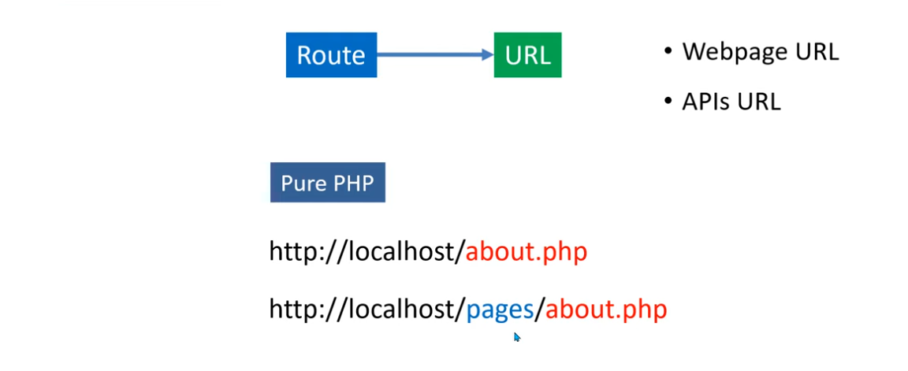
Routing

Slide 3
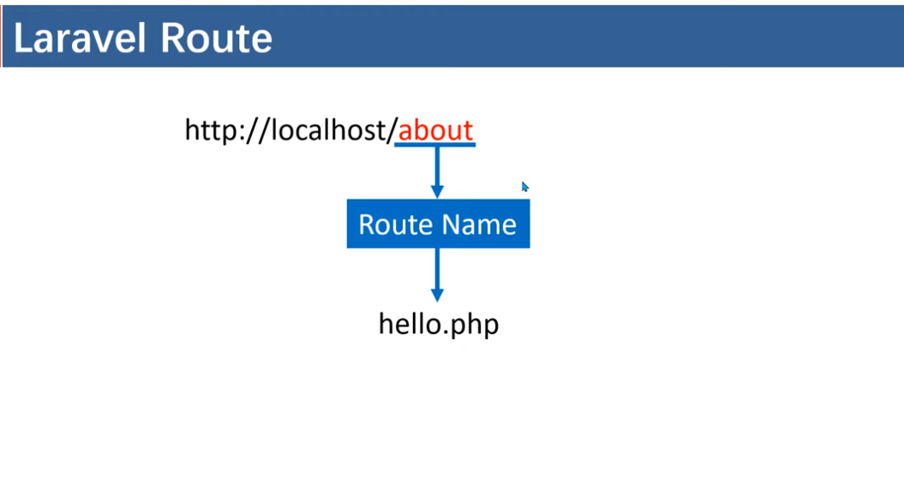

Slide 4
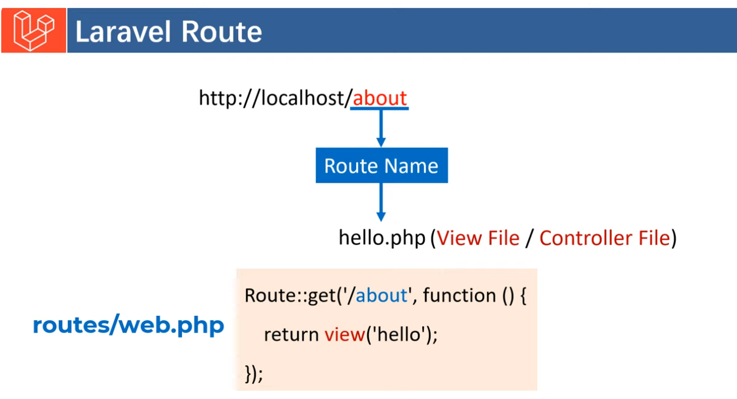
If View File, then only Static Data. If it is Controller File, then data will be coming from database

Slide 5
By default one route is created by Laravel
Route::get('/', function () {
return view('welcome');
});
No need to mention welcome.php

Slide 6
Route::get('/')
Route::get('/') defines a route for a GET request to the root URL (/) of your application.
The root URL typically refers to the base of your web application, e.g., http://yourdomain.com/.
Route is a class and get is a function

Slide 7
Closure Function:
The second parameter of Route::get is a closure (anonymous function).
This function will execute when the route is accessed.

Slide 8
Returning a View:
Inside the closure, return view('welcome'); tells Laravel to render and return a Blade view named welcome.
Laravel assumes the view file is located at resources/views/welcome.blade.php.

Slide 9
Overall Action:
When a user visits the root URL of the application, Laravel executes this route and renders the welcome view as the HTTP response.

Slide 10
1. Basic Route (Closure-Based)-Returning a string in a route
Route::get('/greet',function(){
return "Hello World";
});

Slide 11
Route with Parameters
Routes can accept dynamic parameters in the URL.
Route::get('/user/{id}', function ($id)
{ return "User ID: " . $id;
});

Slide 12
Styling within Route
Route::get('/user/{id}',function($id){
return "<h1 style='color:red'> User Id is: $id <h1>";
});

Slide 13
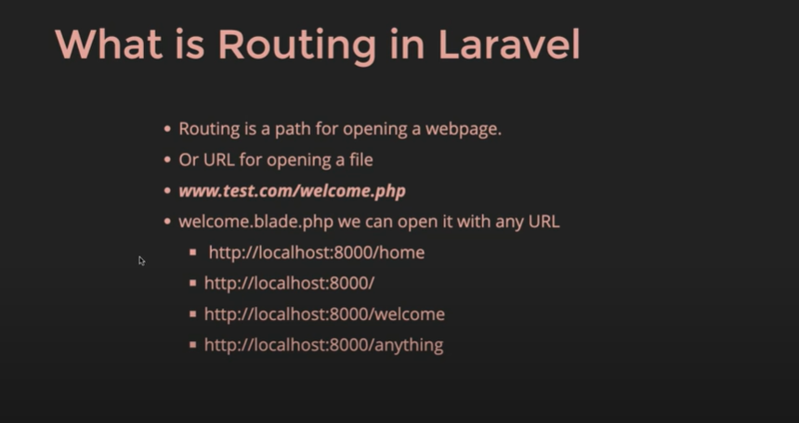
Routing in Laravel

Slide 14
Blade Template
<h1> Welcome to the Products Page</h1>
{{ $name}}

Slide 15
Commands for route
php artisan route: list
php artisan route: clear
php artisan route: cache
Shows all registered routes in your Laravel app.

Slide 16
Common Route Commands You Should Know
Command | Purpose
route:list | Show all routes
route:cache | Cache routes (faster production)
route:clear | Clear route cache
route:list --name=users | Filter by name
route:list --method=GET | Filter by method

Slide 17
Commands for route
php artisan controller-h

Slide 18
Command to check all the routes
php artisan route:list
This will tell us about list

Slide 19
List all the routes having the path- home
php artisan route:list --path=home

Slide 20
Php artisan route:cache -h

Slide 21
Command to display only the routes created by you
php artisan route:list --except-vendor

Slide 22
Passing Data to Views
Route::get('/greet', function () {
return view('greet', ['name' => 'John']);
});

Slide 23
In the view (greet.blade.php):
<h1>Hello, {{ $name }}</h1>

Slide 24
Alternative Syntax:
return view('greet')->with('name', 'John');

Slide 25
Passing multiple variables:
return view('greet', ['name' => 'John', 'age' => 25]);

Slide 26
Pass it as Arrays
Route::get("/new",function(){
return view("newview",["arr"=>["a,b,c,d,e,f"]]);
});

Slide 27
<?php
print_r($arr);
?>

Slide 28
Compact
Route::get("/new",function()
{
$name="Amit";
return view("newview",compact("name"));
});

Slide 29
<?php
echo $name;
echo "<br>";
?>

Slide 30
With Method
Route::get("/new",function()
{
// $name="Amit";
// $address = "Ludhiana";
return view("newview")->with("name","Amit")->with("Address","Ludhiana")->with("Pin","12108");
});

Slide 31
With Method
<h1> This is new View </h1>
<?php
echo $name;
echo "<br>";
echo $Address;
echo "<br>";
echo $Pin;
// print_r($arr);
?>

Slide 32
withName()
Route::get("/new",function()
{
$name="Aman";
$address = "Ludhiana";
$pin=1234;
return view("newview")->withName($name)->withAddress($address)->withPin($pin);
});

Slide 33
Newview.blade.php
<?php
echo $name;
echo "<br>";
echo $address;
echo "<br>";
echo $pin;
// print_r($arr);
?>

Slide 34
Passing the data as an array
Route::get("/arraypass",function(){
return view('aboutus',["data"=>[10,20,30,40,50]]);
});

Slide 35
Providers🡪 AppServiceProvider.php
public function boot(): void
{
//
View::share('tax','25%');
}

Slide 36
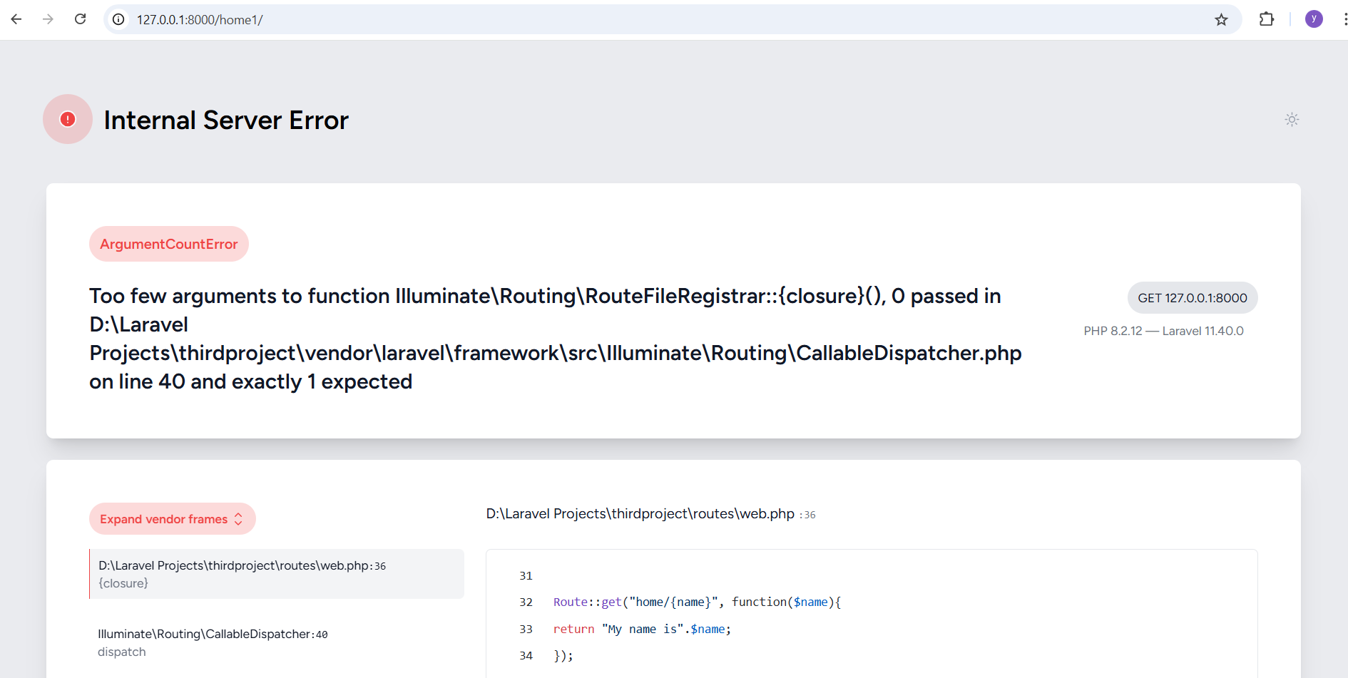
Default Parameter

Slide 37
Add the correct use statement for the View facade at the top of the file:
use Illuminate\Support\Facades\View;

Slide 38
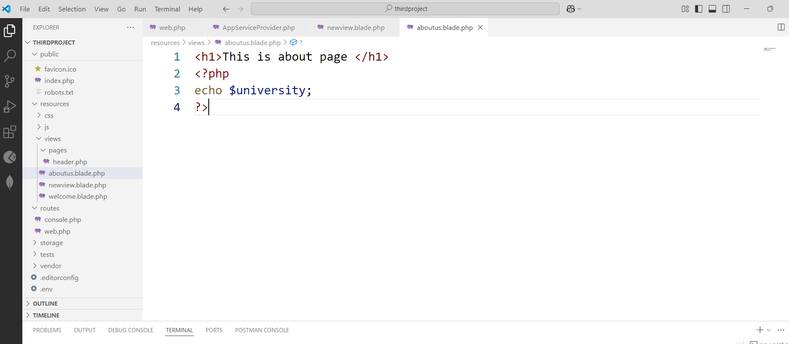
Accessing Global Variable in Multiple View File

Slide 39
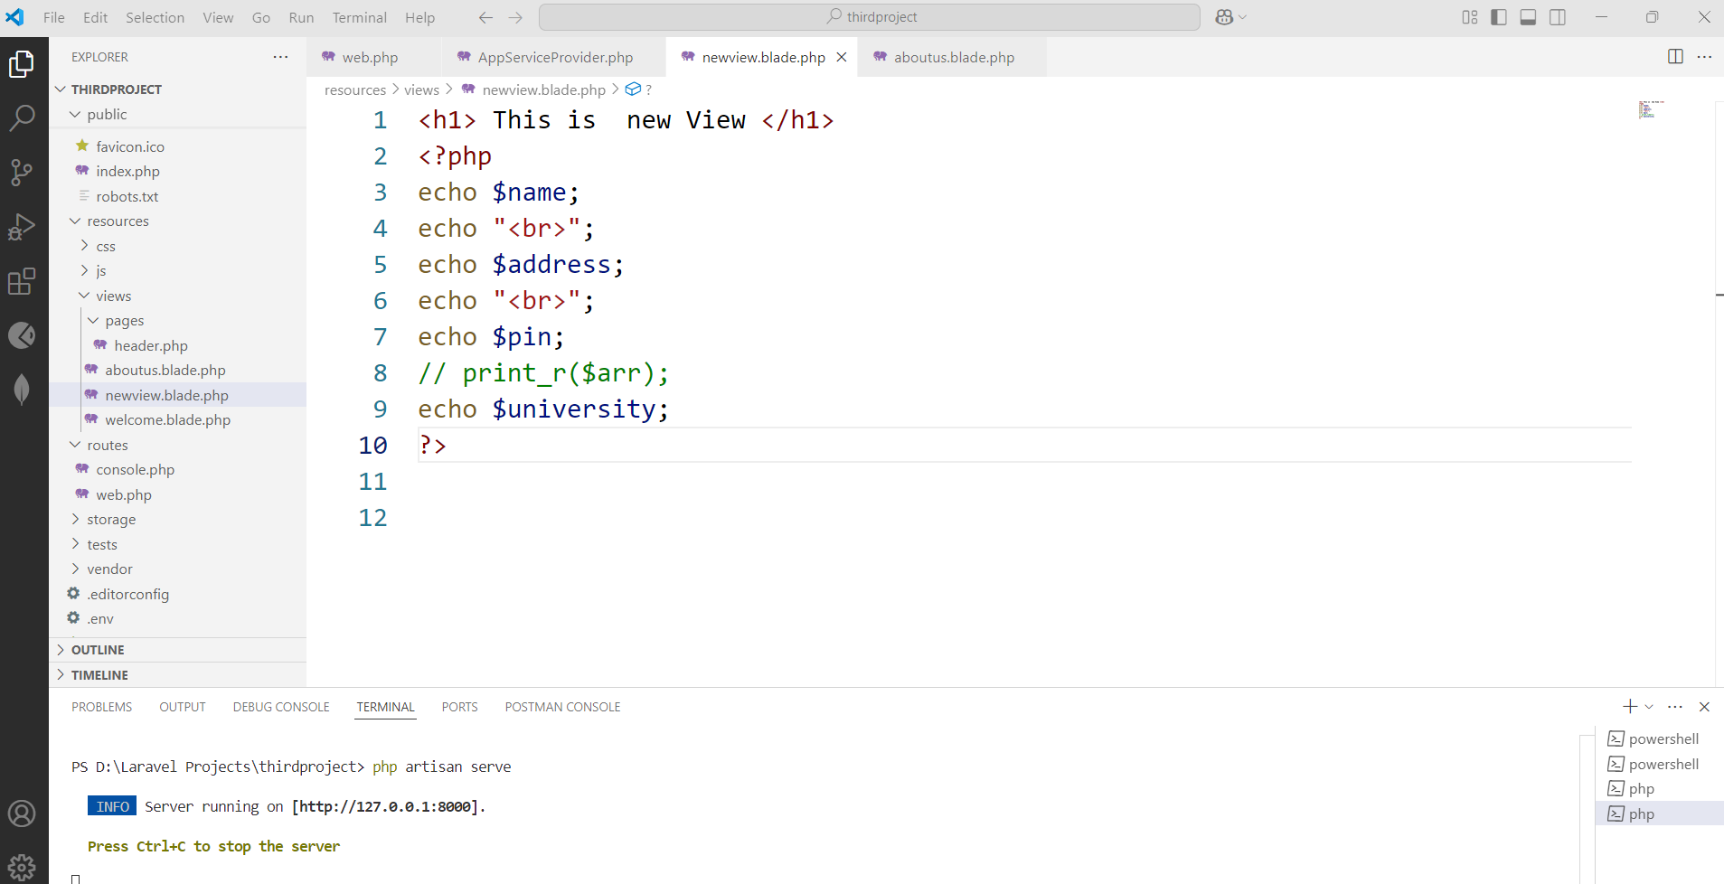
Local and Global Variables Together

Slide 40
The View::share method
The View::share method makes the variable (tax in this case) globally available in all views.
You can access it in any Blade view

Slide 41
If you're sharing multiple variables, consider grouping them into an array
View::share([
'tax' => '25%',
'currency' => 'USD',
]);

Slide 44
if- elseif
@if($price<2500)
<p>Product is cheap </p>
@elseif($price>25000 && $price<50000)
<p>Product is Normal </p>
@else
<p>Product is Costly </p>
@endif

